Slide 1

LUCA AGM 2023

Slide 2

Chair’s update
Welcome to the 2023-24 season!
Apologies
Teams meeting format
Clubs please message Paddy so we know who is here
2022-23 round-up
Sustainable finance
Structural simplification
Focus on core offering
Looking ahead to 2023-24
Committee ‘elections’

Slide 3
2022-23 season round-up
Total number of LUCA registered athletes 2699 as of June this year
Across XC league total of 244 runners (128M 116F)
Indoors 274 entries (2nd highest ever)
Open meet 142 entries, Outdoor Champs 154 (down on previous years)
Sustainable finance – Paddy
Structural simplification – executive committee + organising committees
Focus on core offering
Reduced number of XC races
Introduction of the LUCA ‘Pre-BUCS’ open
Singular Outdoor Championships

Slide 4
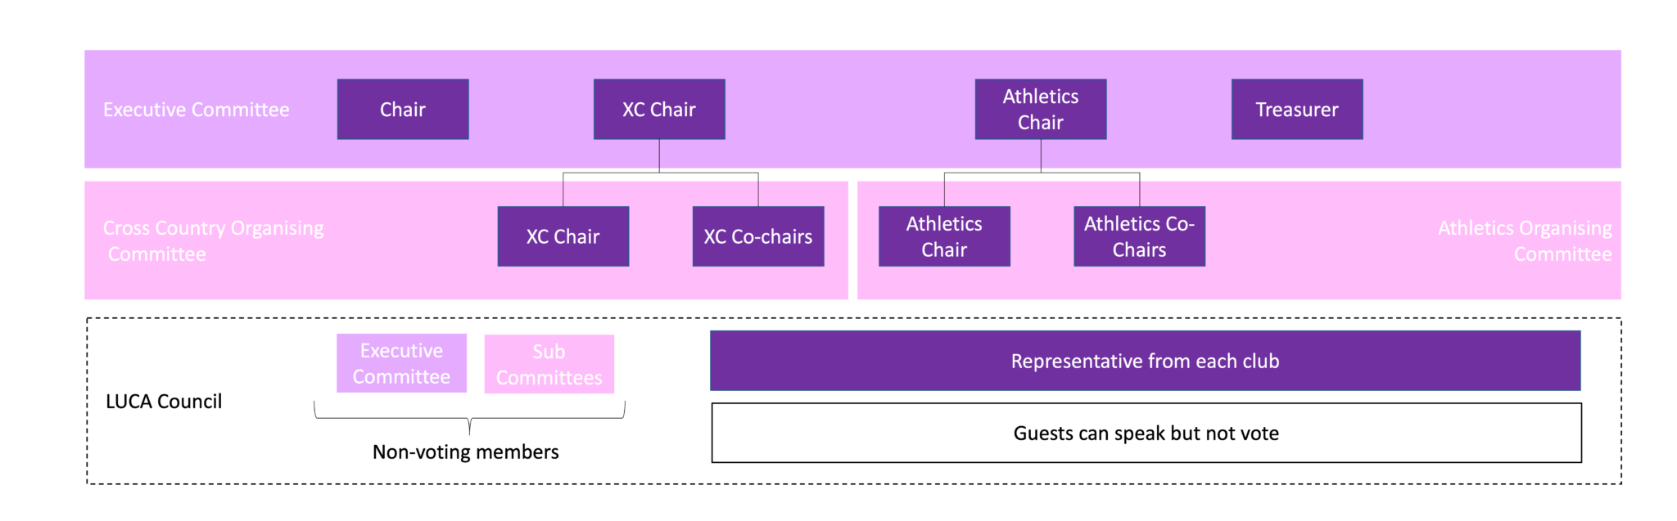
Committee elections
The behind the scenes of LUCA
Executive:
Chair: Dr James Findon AKA the godfather of LUCA
Treasurer: Dr Patrick Roddy
XC Chair: Abhilash Sivaraman
XC Organising committee – we need more help please!
Athletics Chair: Dr Christian Pugsley
Athletics OC – currently a mix of alumni/current students

Slide 5

Financial statement
Over to Paddy

Slide 6
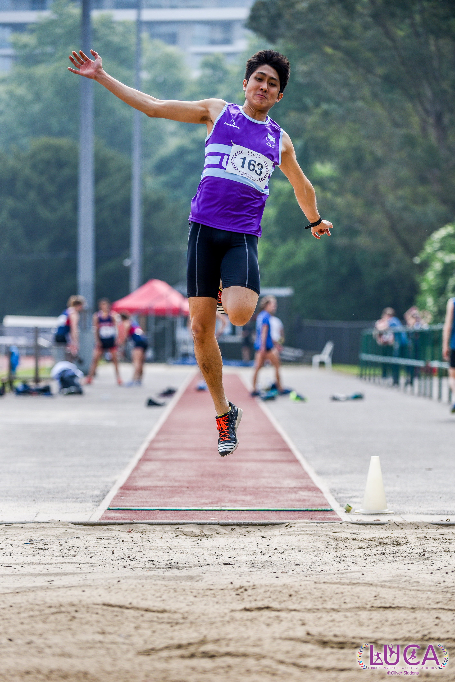
The upcoming year…
XC update – Abhilash
Key dates:
Parliament Hill 18/10
Wimbledon 15/11
Mitcham Common 24/01
Wormwood Scrubs 21/02
Every runner NEEDS a LUCA ID to compete
Athletics update – Christian
LUCA Indoor Championships 2023
Lee Valley 25th November
Entries via OpenTrack

Slide 7

LUCA Affiliation
What does it mean to be affiliated to LUCA?
Widening participation
More clubs, more athletes, more influence…
Better cash flow
Concerns?
Clubs keen to affiliate
University of East Anglia
University of Kent

Slide 8
Alumni Update
Motspur officially closed
No current alumni offering
Survey open currently – main interests in ability to compete at LUCA events and socialising
Aim to improve alumni offering in future

Slide 9
Committee nominations
No formal executive elections this year
We will need an understudy for treasurer this year
Any help is much appreciated
Please either raise your virtual hand or message me/Abs for more information

Slide 10
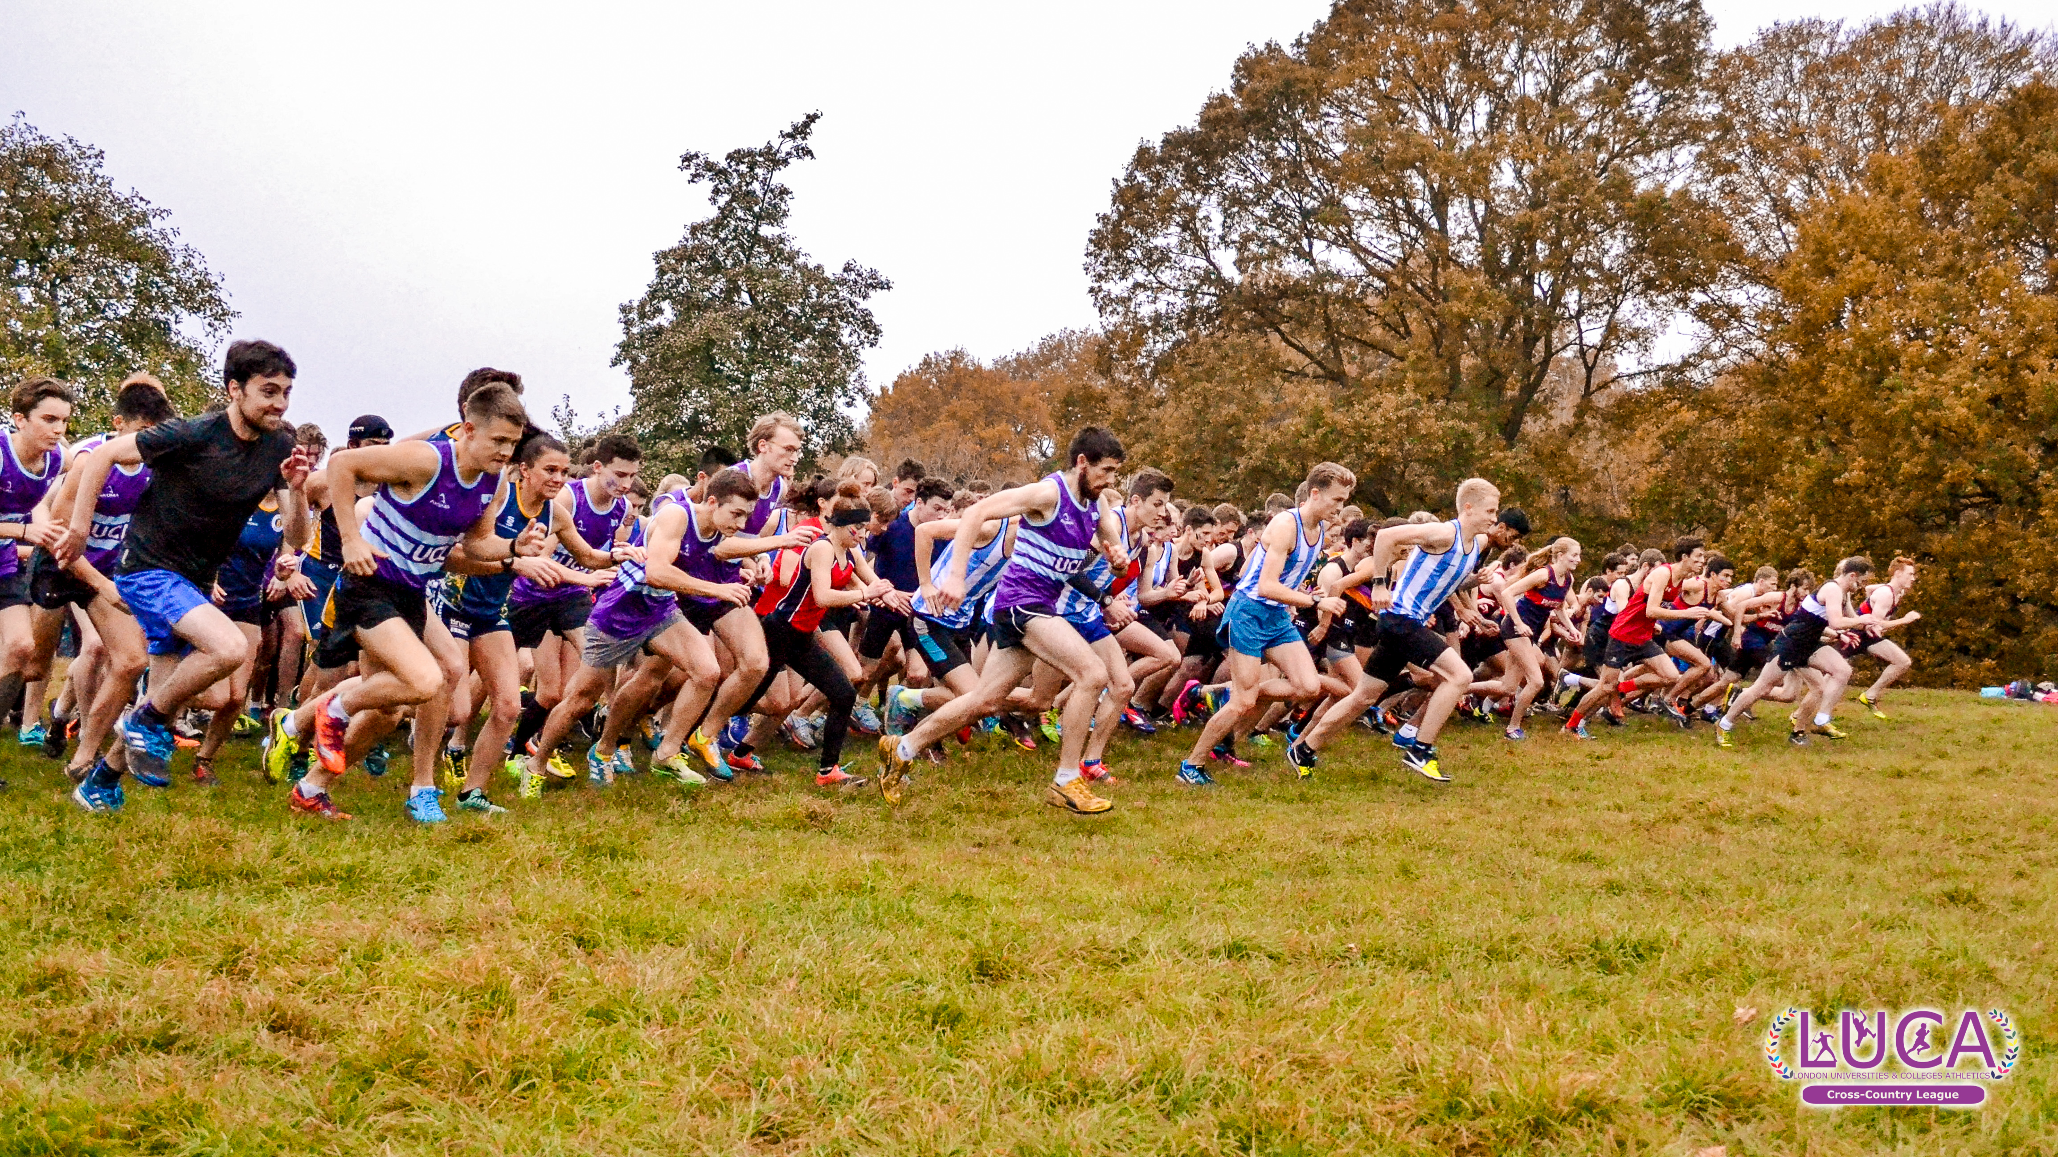
Any other business
Feel free to raise any issues/concerns/questions/feedback
Anything you think has gone particularly well is also very welcome to be highlighted!
Thank you for coming and best of luck for the 23-24 season!

